Slide 1
Data Development Utilizing Database Design and SQL
Day 1

Slide 2
What Is a Database?
Relational Database: a structure containing categories of information and relationships between these categories
Categories: sales reps, customers, orders, and items
Relationships between categories: sales rep-to-customer and customer-to-orders

Slide 3
What Is a Database?
Some examples of databases you may encounter in your daily life are:
a telephone book
T.V. Guide
airline reservation system
motor vehicle registration records
papers in your filing cabinet
files on your computer hard drive.
Why do people and organizations need databases?
Keep records of their:
Clients
Staff
Volunteers
To keep a record of activities and interventions;
Keep sales records;
Develop reports;
Perform research.

Slide 4



History of Relational Databases
Early 1960s
Integrated data store, first general-purpose DBMS designed by Charles Bachman at GE
Late 1960s
IBM developed Information Management System (IMS), used even today in many major installations
IMS formed the basis for hierarchical data model
American Airlines and IBM jointly developed SABRE for making airline reservations
SABRE is used today to populate Web-based travel services such as Travelocity
1970
Edgar Codd, at IBM’s San Jose Research Laboratory, proposed relational data model.
It sparked the rapid development of several DBMSs based on relational model, along with a rich body of theoretical results that placed the field on a firm foundation.
1980s
SQL query language, developed as part of IBM’s System R project, is now the standard query language

Slide 5
The TAL Distributors Database
TAL distributors is a wholesaler of finely crafted wooden toys, games, and puzzles
Manual system no longer feasible for managing customer, order, and inventory data
Database management system will allow for current, accurate data with useful reports

Slide 6
Required Data for Sales Reps
Number
Last name
First name
Address
Total commission
Commission rate

Slide 7
Required Data for Customer
Customer number
Name
Address
Current balance
Credit limit
Sales rep number

Slide 8
Required Data for Items
Item number
Description
Number of units on hand
Item category
Number of the storehouse where the item is stored
Unit price for each item in inventory

Slide 9
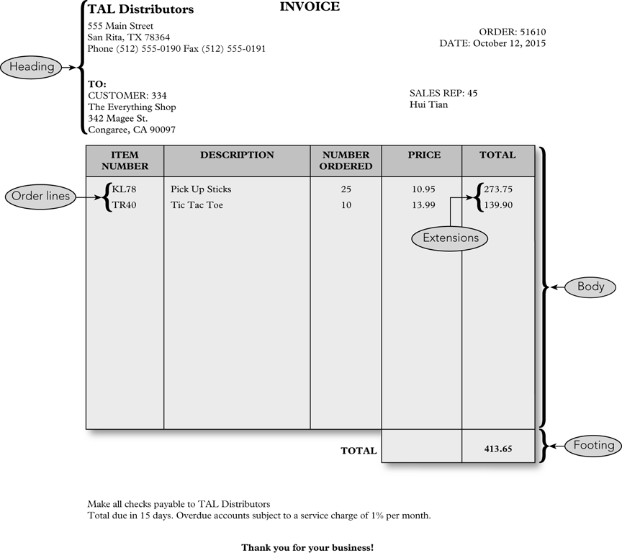

Slide 10
Components of a Sample Order
Heading (top of the order form)
Order number and date
Customer number, name, address
Sales rep number and name
Body (center of the order form)
One or more order lines or line items
Footer (bottom of the order form)
Order total

Slide 11
Components of a Line Item
Item number
Item description
Number of units for the item ordered
Quoted price for the item
Total, or extension, the result of multiplying the number ordered by the quoted price

Slide 12
Items Stored for Each Order
Order number
Date of the order
Customer number
Customer name, address, and sales rep information are stored with the customer information
Sales rep name is stored with sales rep information
Order number, item number, number of units ordered
Quoted price
Item description is stored with information on items
Order total is not stored but is calculated each time order is displayed or printed

Slide 13
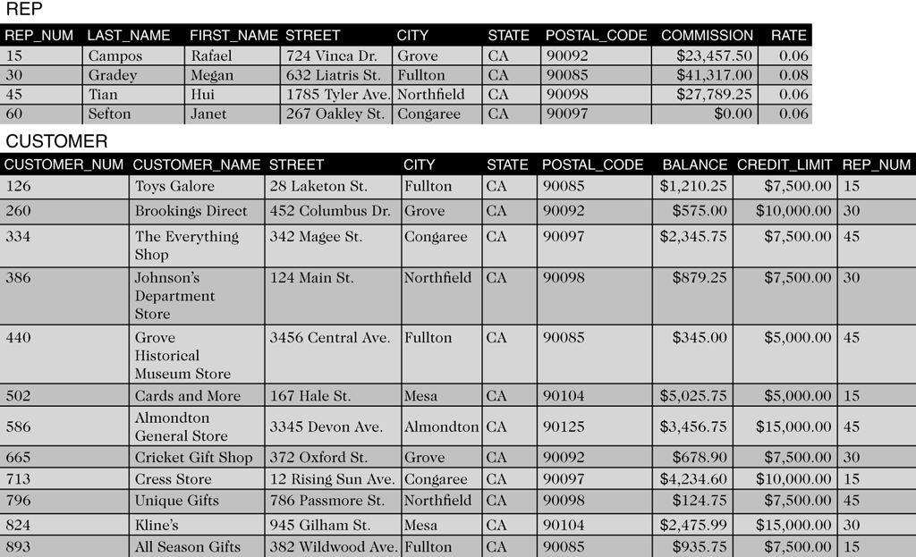
Sample Rep Table
Three sales reps in the table identified by number
Sales rep number: 15
Name: Rafael Campos
Address: 724 Vinca Dr., Grove, CA 90092
Total commission: $23,457.50
Commission rate: 6% (0.06)

Slide 14
Sample Customer Table

Slide 15
Customer Table Example
Twelve customers are identified by number
Number: 126
Name: Toys Galore
Address: 28 Laketon St., Fullton, CA 90085
Current balance: $1,210.25
Credit limit: $7,500.00
Sales rep: 15 (Rafael Campos)

Slide 16
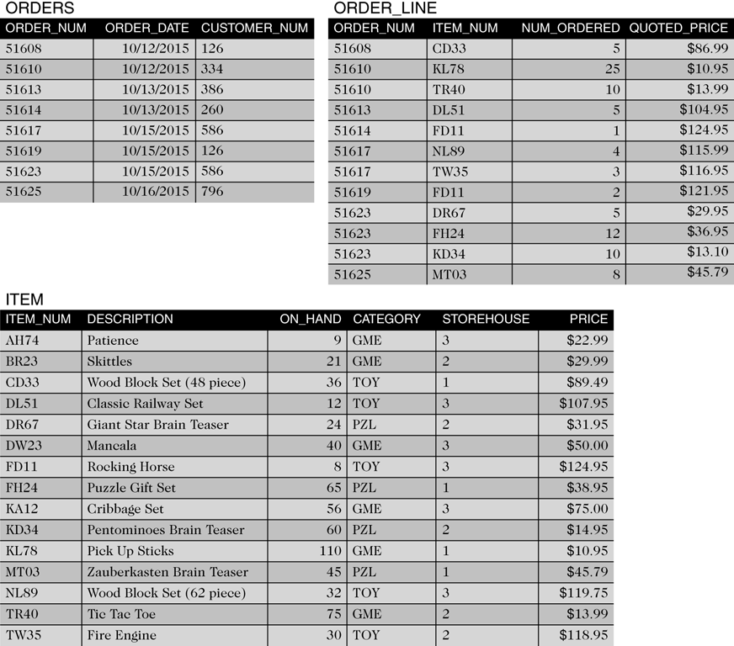
Sample Item Table

Slide 17
Item Table Example
Fifteen items are listed by item number
Item number: AH74
Description: Patience
Units on hand: 9
Category: GME (game)
Storehouse: 3
Price: $22.99

Slide 18
Sample Orders Table

Slide 19
Orders Table Example
Eight orders listed by order number
Order number: 51608
Order date: 10/12/2015
Customer: 126 (Toys Galore)

Slide 20
Sample Order_Line Table

Slide 21
Order_Line Table Example
Twelve order line items listed by order number
Order number: 51608
Item number: CD33 (Wood Block Set (48 piece))
Number ordered: 5
Quoted price: $86.99

Slide 22
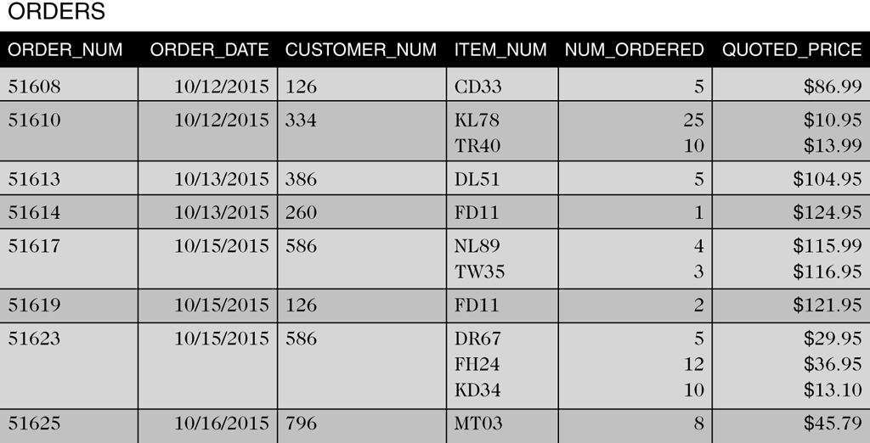
Alternative Orders Table Structure

Slide 23
Alternative Order Table Example
Displays identical data in one table
Each table row contains all of the order lines for each order
Second row, order 51610 has two order lines
Item KL78, Qty 25, Quoted price $10.95 each
Item TR40, Qty 10, Quoted price $13.99 each

Slide 24
Issues with Alternative Order Table
Difficult to track information between columns
Other issues
How much room is allowed for multiple entries?
What if an order has more order lines than you have allowed room for?
For a given item, how do you determine which orders contain order lines for that item?

Slide 25
Benefits of Order_Line Table
Table is less complicated when separated
No multiple entries
Number of order lines is not limited
Finding every order for a given item is simple

Slide 26
Exercise
Create an entity relation diagram using TAL Distributors tables: REP, CUSTOMER, ORDERS, ITEM, ORDER_LINE
Draw a rectangular box for each table, and write the table name inside the box.
Which table has relationship (association) to which other table?
Draw a line between the tables (boxes) that have association between them (i.e. information from one table is contained in another table).

Slide 27
Colonial Adventure Tours Database
Small business that organizes day-long guided trips to New England
Data is to be stored in a database
Needs forms and reports to work with the data
Gathers a variety of information on guides, trips, customers, and reservations

Slide 28
Data for Guide Table
Guide number
Last and First names
Address
Phone number
Hire date

Slide 29
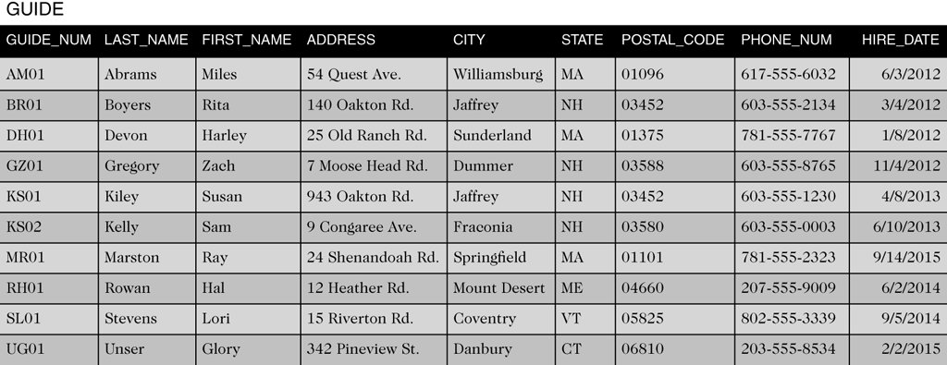
Sample Guide Table

Slide 30
Data for Trip Table
Trip ID
Why is Trip ID needed?
Name
Location and State
Distance
Maximum group size
Trip type
Season

Slide 31
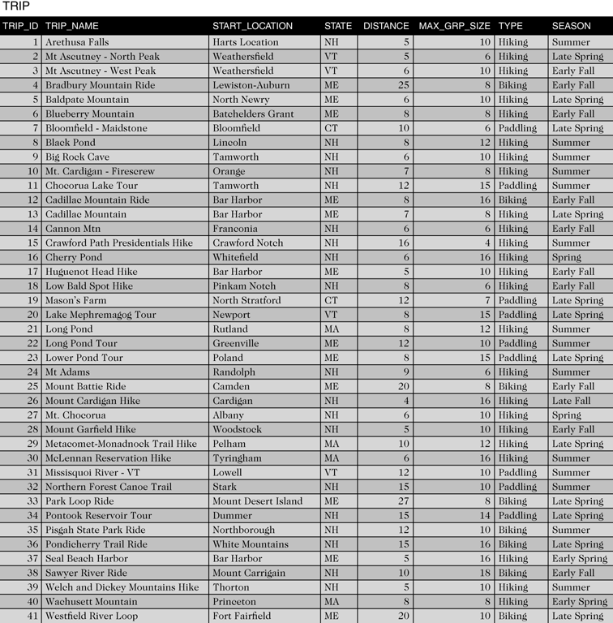
Sample Trip Table

Slide 32
Data for Customer Table
Customer number
Last and First names
Address
Phone

Slide 33
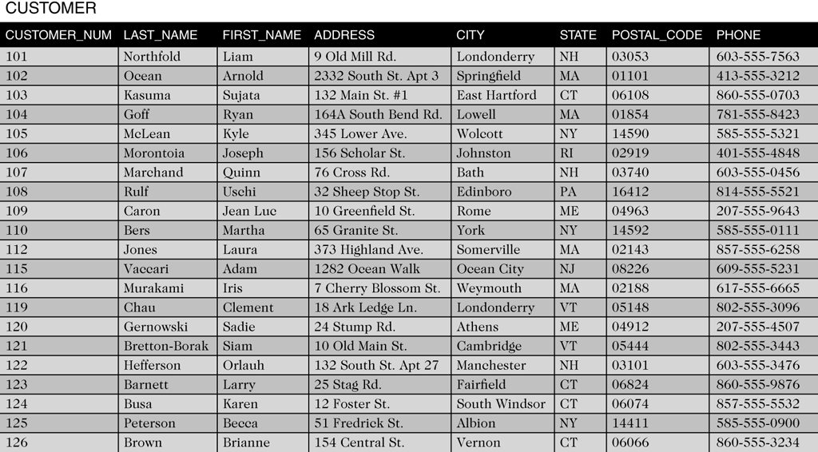
Sample Customer Table

Slide 34
Data for Reservation Table
Reservation ID
Trip ID
Trip date
Number of persons
Price
Other fees
Customer number

Slide 35
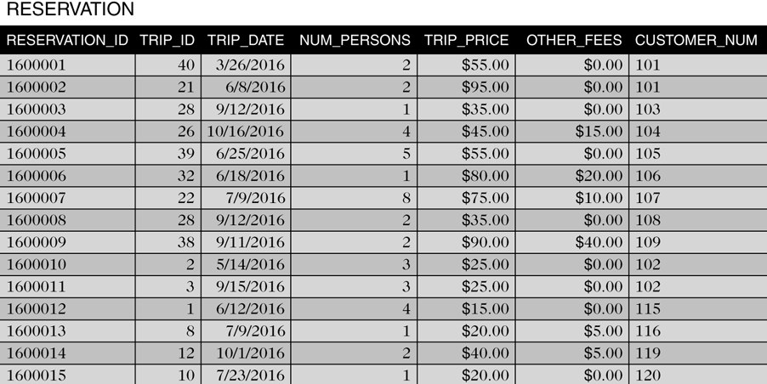
Sample Reservation Table

Slide 36
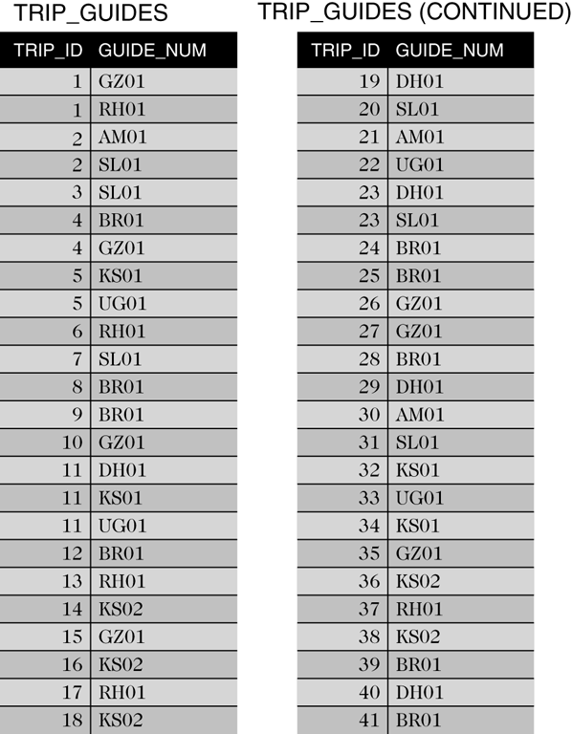
Data for Trip_Guides Table
This table relates trips and guides
Trip ID
Guide number

Slide 37
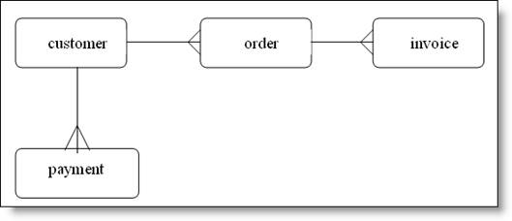
Exercise
Create an entity relation diagram using Colonial Adventure Tours tables: GUIDE, TRIP, CUSTOMER, RESERVATION, TRIP_GUIDES
Determine the association type:
If a record in one table can have multiple records associated to it in another table, this is a one-to-many relationship. Mark it as illustrated in the example below (customer can have multiple orders).

Slide 38
Solmaris Condominium Group Database
Solmaris Condominium Group manages condo complexes
Has two properties and maintains common areas
Also provides maintenance services
Uses database to store information for managing operations

Slide 39
Data for Location Table
Location number
Name
Street Address
City, State, and Postal Code

Slide 40
Data for Owner Table
Owner number
Last and First names
Street Address
City, State, and Postal Code

Slide 41
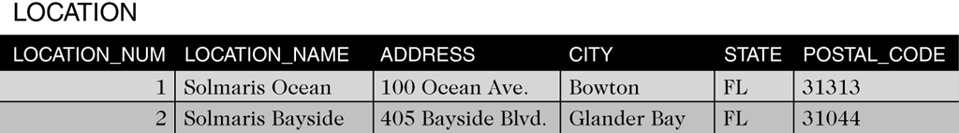
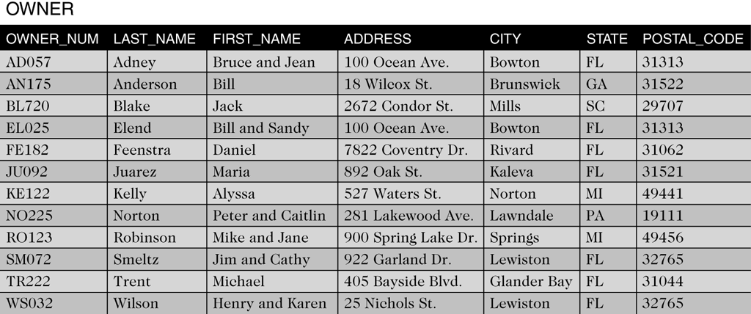
Sample Location and Owner Tables

Slide 42
Data for Condo_Unit Table
Condo ID, Location number, Unit number
Square footage
Bedrooms and Baths
Condo fee
Owner number

Slide 43
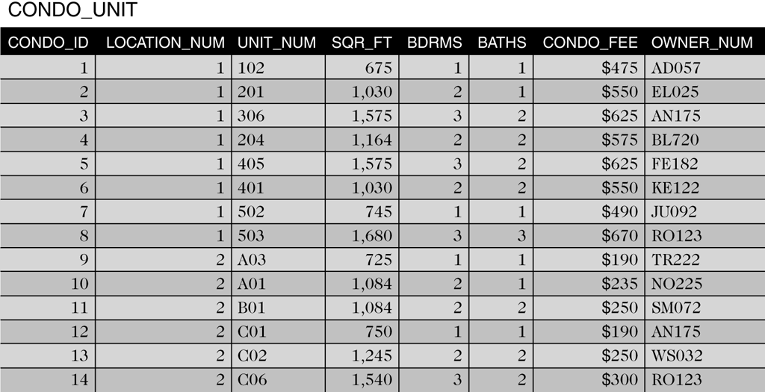
Sample Condo_Unit Table

Slide 44
Service Data
Maintenance service category information is stored in the SERVICE_CATEGORY table
Information on the services requested is stored in the SERVICE_REQUEST table
Stores service category, condo information, description and status, estimated hours, hours spent, and next service date

Slide 45
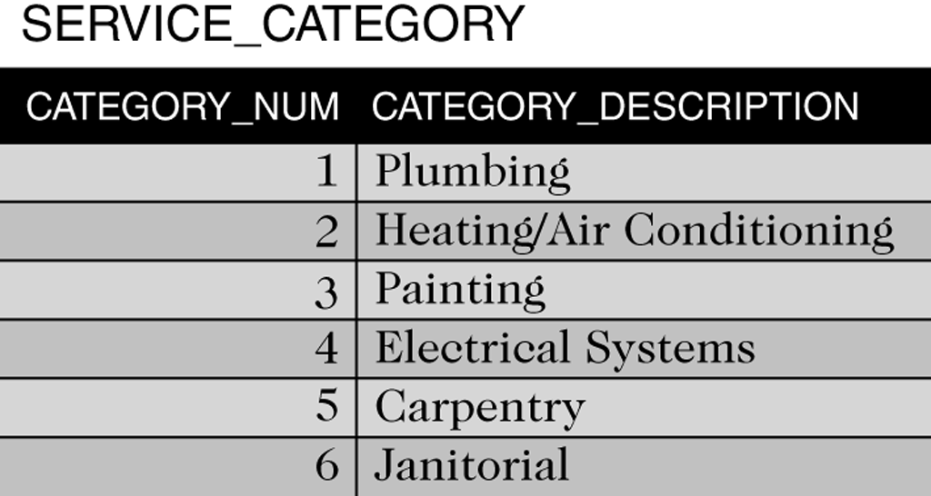
Sample Service_Category Table

Slide 46
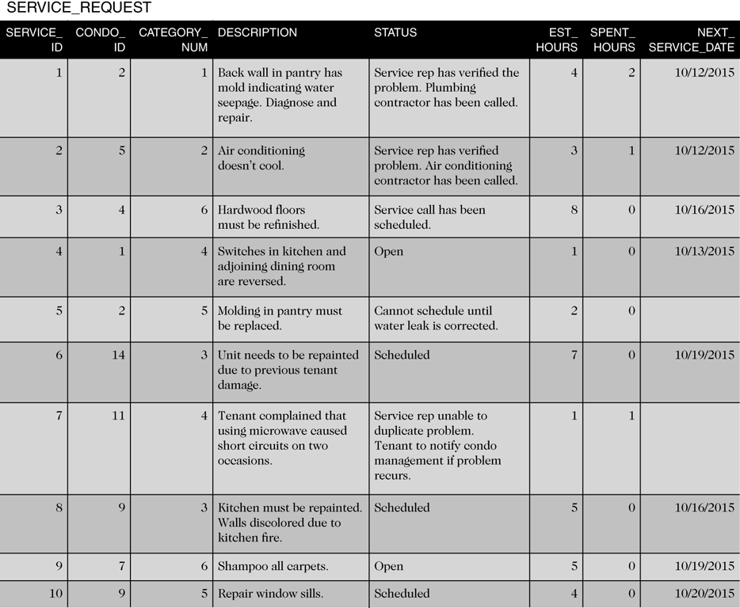
Sample Service_Request Table

Slide 47
Summary
TAL Distributors
Requires rep, customer, items, orders, and order lines
Colonial Adventure Tours
Requires guide, trip, customer, and reservations
Solmaris Condominium Group
Requires condo, owners, condo units, service categories, and service requests

